Slide 1
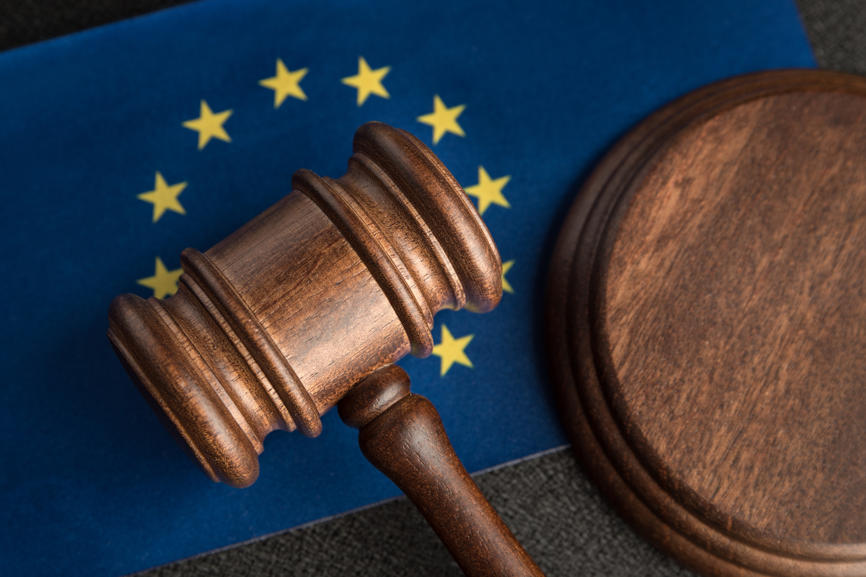
Internationale Handelsgesellschaft
C - 11 / 70 - Internationale Handelsgesellschaft
LAW413
MERVE DALKIRAN- 22202676
K.İDİL SOYDAN - 22202048
DERİN ALTUĞ - 22103827

Slide 2

C-11/70
Background: EU Law Before the Case
The Principle of Supremacy in Eu Law Before Internationale Handelsgesellschaft
No formal basis for “supremacy” in the Founding Treaties
Supremacy emerged through ECJ case law (not treaty text)
Van Gend en Loos (1963): EU as a “new legal order”
Costa v ENEL (1964): supremacy over national legislation
!!! Remaining Uncertainty:
What is the ambit of supremacy, and how far does EU law prevail over national law?

Slide 3

C-11/70
Facts of the Internationale Handelsgesellschaft Case
Export Licence Deposit Dispute
German company paid a deposit to obtain an export licence for maize meal
Could not export full amount → requested refund of unused deposit.
Administrative Authority’s Refusal (Einfuhr-und Vorratsstelle für Getreide)
German authority relied on Regulation 120/67/EEC. ⟶ (Unused deposit must be forfeited under EU rules
Company’s Constitutional Objections
Claimed forfeiture was disproportionate
Alleged violation of German Constitutional Law

Slide 4

C-11/70
Facts of the Internationale Handelsgesellschaft Case (cont.)
Conflict Identified by German Court (Verwaltungsgericht Frankfurt am Main)
(German constitutional principles vs EU Regulation 120/67)(Regulation is directly applicable under Article 189 EEC)
Preliminary Reference to the ECJ
(German court requested ECJ to assess the validity of the EU regulation)
!!!!The importance Of The Preliminary Reference :
enabled the ECJ to issue the Internationale Handelsgesellschaft judgment, thereby consolidating the supremacy doctrine first articulated in Costa v ENEL by affirming the primacy of EU law even over national constitutional norms.

Slide 5

C-11/70
Judgment
The Referral by the Verwaltungsgericht
1. The Core Objection
Refusal of Validity of the EU deposit system.
Purpose of Referral ⟶ ECJ to put an end to the existing "legal uncertainty."
2. The Conflict of Norms (EU Law x National Constitution")
Court ⟶ the deposit system contradicts structural principles of National Constitution
For this case ⟶ Challenging Supremacy ⟶ the primacy of supranational law must yield to the principles of the German Basic Law.
3. Grounds for Annulment (The Violation)
The court claims the EU regulation violates specific fundamental rights guaranteed by the German Basic Law.
Freedom of Action
Economic Liberty
Proportionality
Constitutional Basis: Article 2(1) and Article 14 of the Basic Law.

Slide 6
C-11/70
Proportionality
1. Purpose of the Deposit
To guarantee that imports/exports are actually effected.
2. Violation of Rights?
ECJ states that;
“Precise Knowledge" of market trends ⟶ necessary
Burden: 0.5 unit per ton is not excessive compared to the total value of goods.
Protection: Traders are protected by "Force Majeure" clauses ⟶ deposit is not forfeited if failure is not their fault.
“Deposit System” does not violate fundamental rights.

Slide 7

C-11/70
Judgment
Supremacy over Constitutions
“The validity of measures adopted by Community institutions can only be judged in the light of Community law” (p. 1134, par 3)
The "Independent Source" of Law:
Law stemming from the Treaty is an independent source.
It cannot be overridden by rules of national law, however framed.
Key Declaration
“The validity of a Community measure or its effect within a Member State cannot be affected by allegations that it runs counter to either fundamental rights as formulated by the constitution of that State or the principles of a national constitutional structure.” (p. 1134, par 3)

Slide 8
C-11/70
The Court’s Reasoning
1- Grounding for Supremacy
“...in order to judge the validity
of measures adopted by the institutions of the Community would have an adverse
effect on the uniformity and efficacy of Community law...” (p. 1134)
Rationale: If every Member State could challenge EU law based on its own constitutional rules, the uniformity and efficacy of the entire legal system would collapse.
“...the law
stemming from the Treaty, an independent source of law, cannot because of its
very nature be overridden by rules of national law...”
The judicial foundation for the rule that EU law prevails over all conflicting national law, including constitutional law!
There is still no provision in the founding treaties about Supremacy.

Slide 9
C-11/70
The Court’s Reasoning
2- Grounding for Fundamental Rights
The dilemma: The Court could not assert Supremacy while ignoring rights violations.
“...respect for
fundamental rights forms an integral part of the general principles of law protected
by the Court of Justice...” (p.1134, para 4)
“...The protection of such rights, whilst inspired by the constitutional
traditions common to the Member States, must be ensured within the
framework of the structure and objectives of the Community...”
“...within the
framework of the structure and objectives of the Community...”
Source of these rights: Member State’s common constitutional traditions.
1-structure of the Community | 2-objectives of the Community
Fundamental rights were not listed originally either, but with the Lisbon Treaty, the Charter of Fundamental Rights was accepted.

Slide 10
C-11/70
1974: Nold Case
International treaties (like ECHR) become sources for rights.
1979: Cassis de Dijon
Proportionality Test used.
Established “Mutual Recognition”
1978: Simmenthal
Supremacy: Local courts must apply EU law immediately; no waiting for annulment.
1986: Solange II
German Constitutional Court said “So long as the EU protects rights effectively, the German Court will not exercise jurisdiction.”
1974: Solange I
German Constitutional Court said “As long as the EU has no written bill of rights, the German Court will review EU law.”

Slide 11
C-11/70
Conclusion
Internationale Handelsgesellschaft (C-11/70) is a turning point of EU Law. It established that for EU to sustain, its law must be superior and uniform. But it also indicated that supremacy cannot exist without the protection of basic rights. It started a conflict between ECJ and National Court that acted as a
catalyst for the creation of the Charter of Fundamental Rights of today.

Slide 12
C-11/70
Question
Looking at the 'Solange' dialogue we discussed, do you think the German Constitutional Court was right to challenge the ECJ in the 1970s? Or did their resistance threaten the unity of the European legal order?

Slide 13
Thank You

